Slide 1
The Beast of Bias
Prof. Andy Field

Slide 2
Aims
Assumptions of parametric tests based on the normal distribution
Understand the assumption of normality
Graphical displays
Skew
Kurtosis
Normality tests
Understand Homogeneity of Variance
Levene’s Test
Know how to correct problems in the data
Log, Square Root and Reciprocal Transformations
Pitfalls and alternatives
Robust tests

Slide 3
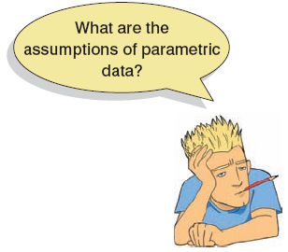
Assumptions
Parametric tests based on the normal distribution assume:
Additivity and linearity
Normality something or other
Homogeneity of Variance
Independence

Slide 4
Outliers can Bias a Parameter Estimate

Slide 5
…and the Error associated with that Estimate

Slide 6
Additivity and Linearity
The outcome variable is, in reality, linearly related to any predictors.
If you have several predictors then their combined effect is best described by adding their effects together.
If this assumption is not met then your model is invalid.

Slide 7
Normally Distributed Something or Other
The normal distribution is relevant to:
Parameters
Confidence intervals around a parameter
Null hypothesis significance testing
This assumption tends to get incorrectly translated as ‘your data need to be normally distributed’.

Slide 8
When does the Assumption of Normality Matter?
In small samples.
The central limit theorem allows us to forget about this assumption in larger samples.
In practical terms, as long as your sample is fairly large, outliers are a much more pressing concern than normality.

Slide 9
Homoscedasticity/ Homogeneity of Variance
When testing several groups of participants, samples should come from populations with the same variance.
In correlational designs, the variance of the outcome variable should be stable at all levels of the predictor variable.

Slide 10
Homoscedasticity/ Homogeneity of Variance
Can affect the two main things that we might do when we fit models to data:
Parameters
Null Hypothesis significance testing

Slide 11
Assessing Homoscedasticity/ Homogeneity of Variance
Graphs (see lectures on regression)
Levene’s Tests
Tests if variances in different groups are the same.
Significant = Variances not equal
Non-Significant = Variances are equal
Variance Ratio
With 2 or more groups
VR = Largest variance/Smallest variance
If VR < 2, homogeneity can be assumed.

Slide 12
Homogeneity of Variance

Slide 13
Independence
The errors in your model should not be related to each other.
If this assumption is violated:
Confidence intervals and significance tests will be invalid.
You should apply the techniques covered in Chapter 20.

Slide 14
Spotting Outliers Example
A biologist was worried about the potential health effects of music festivals.
Download Music Festival
Measured the hygiene of 810 concert-goers over the three days of the festival.
Hygiene was measured using a standardised technique :
Score ranged from 0 to 4
0 = you smell like a corpse rotting up a skunk’s arse
4 = you smell of sweet roses on a fresh spring day

Slide 15
Spotting outliers With Graphs

Slide 17
Spotting Normality
We don’t have access to the sampling distribution so we usually test the observed data
Central Limit Theorem
If N > 30, the sampling distribution is normal anyway
Graphical displays
P-P Plot (or Q-Q plot)
Histogram
Values of Skew/Kurtosis
0 in a normal distribution
Convert to z (by dividing value by SE)
Kolmogorov-Smirnov Test
Tests if data differ from a normal distribution
Significant = non-Normal data
Non-Significant = Normal data

Slide 18
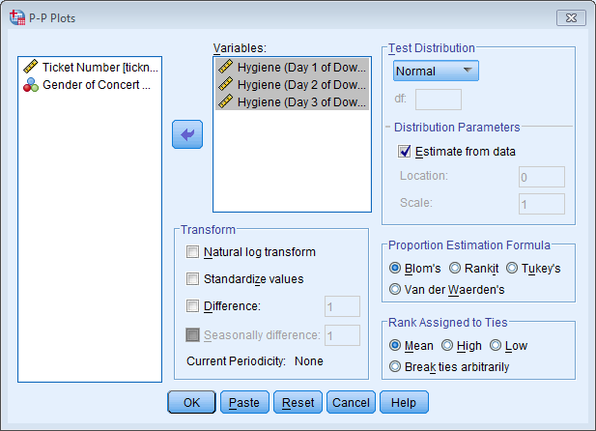
Spotting Normality: The P-P Plot

Slide 19
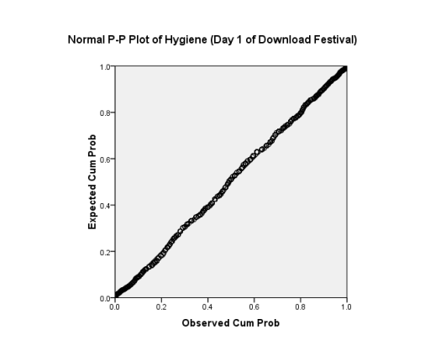
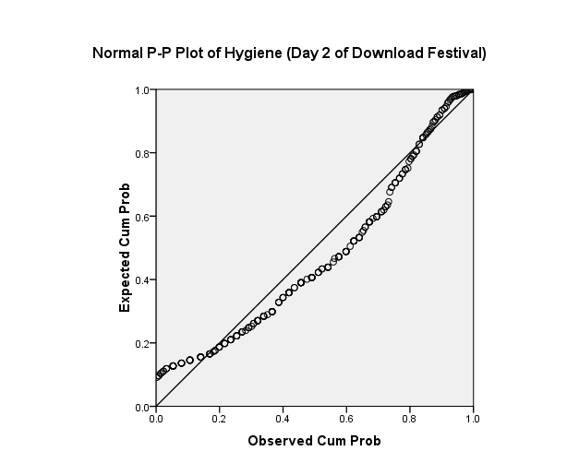
The P-P Plot
Normal
Not Normal

Slide 20
Spotting Normality with Numbers: Skew and Kurtosis

Slide 21
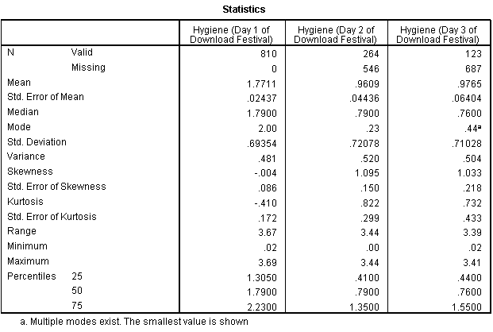
Assessing Skew and Kurtosis

Slide 22
Assessing Normality

Slide 23
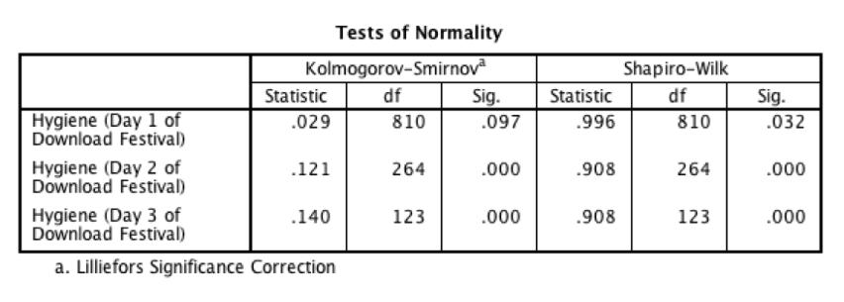
Tests of Normality

Slide 24
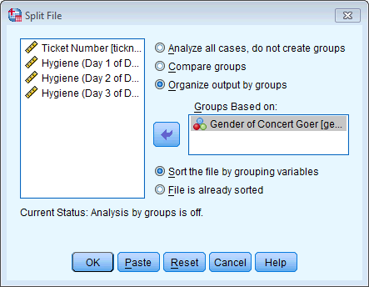
Normality within Groups
The Split File command

Slide 25
Normality Within Groups

Slide 26
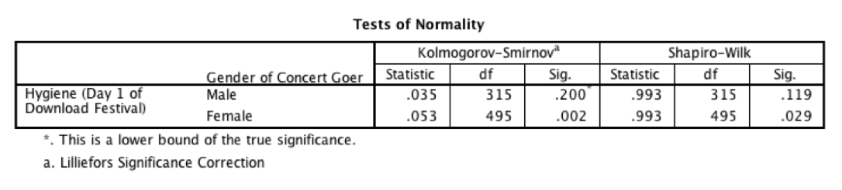
Normality within Groups

Slide 27
Spotting problems with Linearity or Homoscedasticity

Slide 28
Assessing Homogeneity of Variance

Slide 29
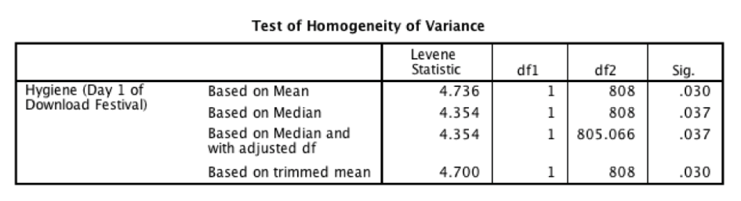
Output for Levene’s Test

Slide 30
Reducing Bias
Trim the data:
Delete a certain amount of scores from the extremes.
Windsorizing:
Substitute outliers with the highest value that isn’t an outlier
Analyse with Robust Methods:
Bootstrapping
Transform the data:
By applying a mathematical function to scores.

Slide 31
Trimming the Data

Slide 32

Robust Methods: Examples
 | Comparing Treatments | Relationships
Principle | Bootstrap | Bootstrap
 | Trimmed Means | Least Trimmed Squares
 | M-estimators | M-estimators
 | Median | Least Median of Squares
Equivalent Tests | T-test | Correlation
 | ANOVA (Including factorial) | Regression
 | ANCOVA | ANCOVA
 | MANOVA

Slide 33
Transforming Data
Log Transformation (log(X_{i}))
Reduce positive skew.
Square Root Transformation (√X_{i}):
Also reduces positive skew. Can also be useful for stabilizing variance.
Reciprocal Transformation (1/ X_{i}):
Dividing 1 by each score also reduces the impact of large scores. This transformation reverses the scores, you can avoid this by reversing the scores before the transformation, 1/(X_{Highest} – X_{i}).

Slide 34
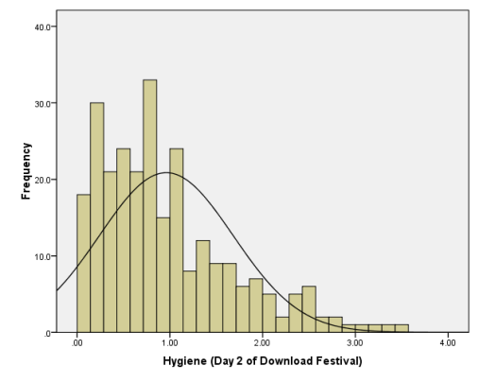
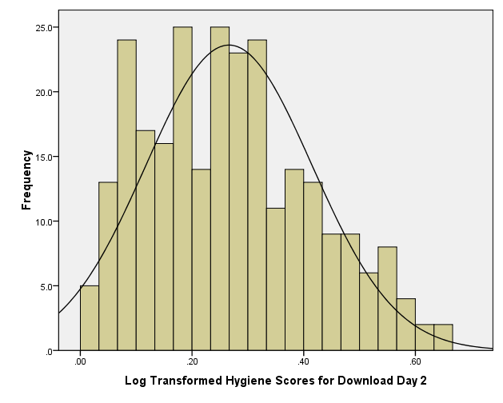
Log Transformation
Before
After

Slide 35
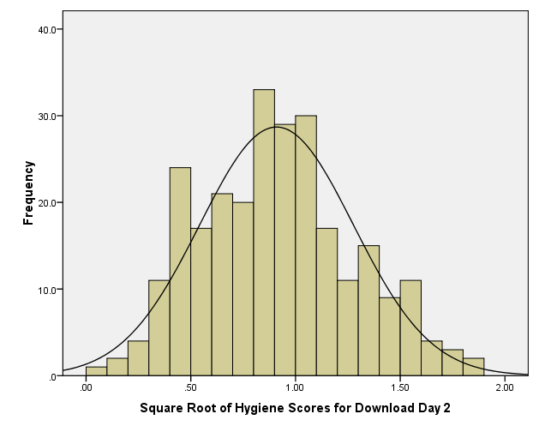
Square Root Transformation
Before
After

Slide 36
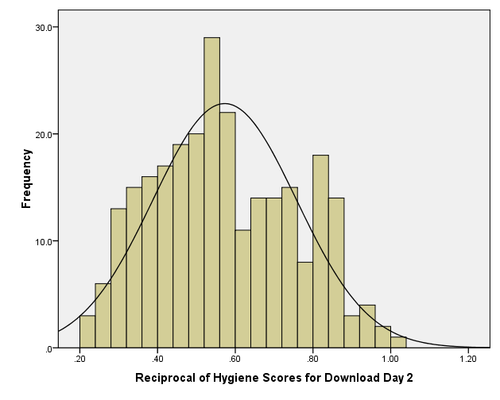
Reciprocal Transformation
Before
After

Slide 37
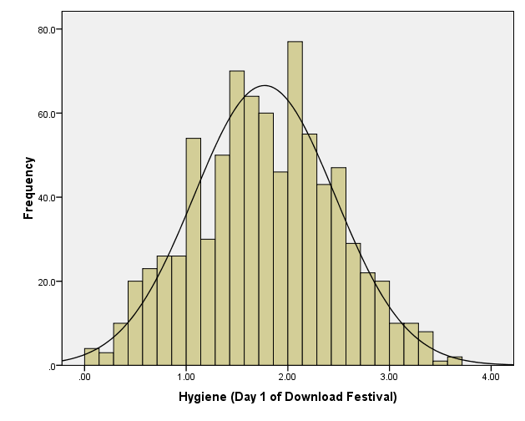
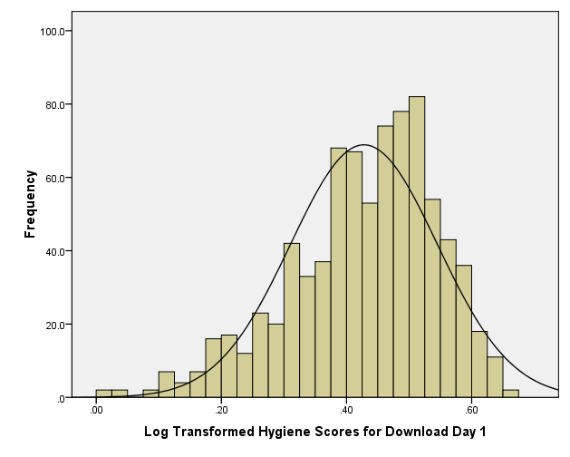
But …
Before
After

Slide 38

To Transform … Or Not
Transforming the data helps as often as it hinders the accuracy of F (Games & Lucas, 1966).
Games (1984):
The central limit theorem: sampling distribution will be normal in samples > 40 anyway.
Transforming the data changes the hypothesis being tested
E.g. when using a log transformation and comparing means you change from comparing arithmetic means to comparing geometric means
In small samples it is tricky to determine normality one way or another.
The consequences for the statistical model of applying the ‘wrong’ transformation could be worse than the consequences of analysing the untransformed scores.

